Slide 1
CptS 327
Stuxnet
Notes:
Template-WSU Hrz 201.ppt

Slide 2
Today’s Topics
Critical Infrastructure
  Substation device layout
Stuxnet
  Operation Olympic Games
  Operation SecretTwin
Notes:
Template-WSU Hrz 201.ppt

Slide 3
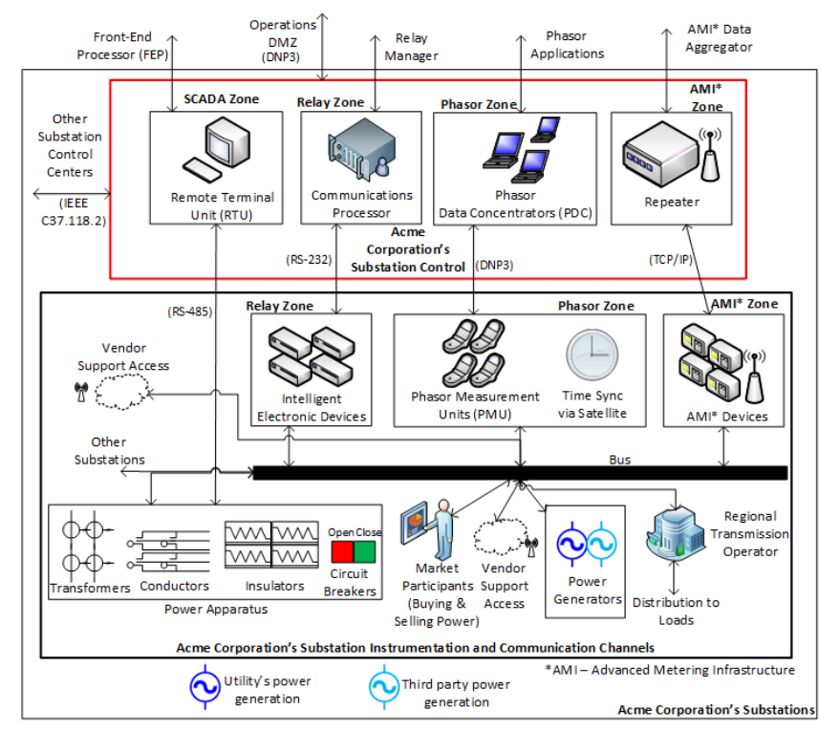
Substation Device Layout
Notes:
Template-WSU Hrz 201.ppt

Slide 4
Stuxnet
Discovered in 2010, deployed from 2005 to present
Cyber weapon developed by Israel and US
  Cyber weapon?
    Malware developed by a nation state to attack another nation state
    Not cost efficient to be used by individuals or smaller groups
Notes:
Template-WSU Hrz 201.ppt

Slide 5
Stuxnet
Features
  Sabotages Phasor and SIEM / SCADA systems
    Corrupts PLCs and PMUs
  Targets Windows 2000 to Windows 8.1
    Including Server versions up to Server 2012 R2
  Targets Siemens Step7 firmware
    Controls many PLCs, including non-Siemens
Impact
  Over 250,000 systems infected worldwide
    More than 1,500 physically destroyed
  59% Iran, 19% Indonesia, 9% India, 3% Azerbaijan
Notes:
Template-WSU Hrz 201.ppt

Slide 6
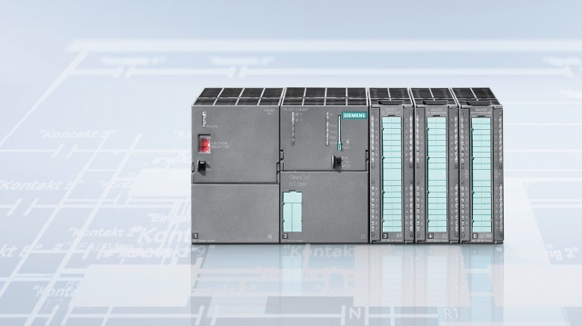
Siemens S7-300
Notes:
Template-WSU Hrz 201.ppt

Slide 7
Stuxnet Phases
Three phases
  Infect by exploiting 0-day vulnerabilities
    TrojanDropper:Win32/Stuxnet
  Reproduce, scan, and deliver payload
    Link:Win32/Stuxnet
      Spoofing, man-in-the-middle, and tampering
  Evade detection by camouflaging as a native system file
    Rootkit:RKT_STUXNET
  Self-destroy after corrupting the controllers
    RMBTK/Stuxnet
Method of transmission
  USB drives
    Provides ability to cross any air gaps
      Air gap: physical and network disconnection between devices
Notes:
Template-WSU Hrz 201.ppt

Slide 8
Original Stuxnet 0-days
0-day vulnerabilities exploited
  MS11-087: Win32k TrueType font parsing engine allowed executables to run without necessary privileges
  MS08-067: Creating a shortcut in the kernel registry allows executables to run without privileges, even after changing the shortcut target path
  MS10-046: Printer spooler accepted code and executed that code without privileges
  CVE-2010-2772: Siemens PLCs accepted code from Windows Credential Controller (WinCC) without checking for privileges
Notes:
Template-WSU Hrz 201.ppt

Slide 9
Operation Olympic Games
Olympic Games?
  Name given to the 2005 to 2010 Iranian nuclear sabotage program
  First major cyber attack on a nuclear grid
Outline
  Load Stuxnet into hundreds of USB drives
  Place the drives at strategically identified trapping locations
    Booths at technical conferences
  Hope for an engineer to take the USB drive and plug into the critical network
Outcome
  Success
  25% of Iran’s nuclear centrifuges damaged
    10% completely destroyed
Notes:
Template-WSU Hrz 201.ppt

Slide 10
Operation SecretTwin
SecretTwin?
  Name given to the 2013 North Korean nuclear sabotage program
Outline
  Compromise a technology provider (Dr. A. Q. Khan)
  Load Stuxnet onto USB drives, along with legitimate resource files
  Use the compromised agent to transfer the drives into the target network
  Hope for an engineer to plug the USB drive to the critical network
Outcome
  Failure
  No damage to the North Korean nuclear program
Notes:
Template-WSU Hrz 201.ppt

Slide 11
Stuxnet Derivatives
0-day exploits, once discovered, are usually fixed in a rapid response
Attackers end up having to find find other exploits
  Leads to variation in the 0-days used for exploitation
    Creates different variations of the same malware
Stuxnet derivatives: Duqu, Flame, Boost, Flask, Euphoria, etc….
Zero Days (2016) by Alex Gibney is a dramatized documentary of Stuxnet events
  Operation Olympic Games
  And the subsequent Operation Nitro Zeus
    No verifiable records
    Discussion stems from speculation
Notes:
Template-WSU Hrz 201.ppt

Slide 12
Lessons Learnt
Regular maintenance (updates and upgrades)
Train employees to increase awareness
  Never plug-in a random USB drive into a critical system
Vendors release system cleaning tools periodically to scan and remove malware
  Most deployments ignore system cleaning if asymptomatic
  Use system cleaning tools to scan even if nothing is seemingly wrong
Notes:
Template-WSU Hrz 201.ppt

Slide 13
Stuxnet: Follow-up
Should I not use USB drives at all?
  Wipe the drive before use
  Use a boot sector wiping algorithm
    https://dban.org/blancco-drive-eraser/
Why is it not sufficient to use ‘Quick Format’?
Notes:
Template-WSU Hrz 201.ppt

Slide 14
Memory Formatting
What is ‘data’? 1s and 0s
What is ‘memory’? Registers to hold the 1s and 0s
How do we access data? Using a file system
What is a file system? Controls how data is stored & retrieved from memory
  Without a file system, the OS can’t read the 1s and 0s
  Many file systems
    Most popular: exFAT (Windows), ext3 (*nix), APFS (macOS)
Depending upon the file system
  Indices
    Memory segmentation
    Access tables
Notes:
Template-WSU Hrz 201.ppt

Slide 15
Memory Formatting
‘Quick Format’ deletes the access table
  Does not destroy and rebuild memory segmentation
Advantages
  Very short processing time
  Allows for the ‘file recovery’ phenomenon
    A program can read the memory segments and rebuild access table
Disadvantages
  Malware files also persist along with other benign files
‘Full Format’ deletes the entire file system index
  Destroys and rebuilds memory segments
  Possible for bad sectors to exist, allowing malware to persist
Notes:
Template-WSU Hrz 201.ppt

Slide 16
Next lecture
Presentation & Interview Assignment Discussion
Notes:
Template-WSU Hrz 201.ppt

Slide 17
Any questions?
Notes:
Template-WSU Hrz 201.ppt

